Slide 1

TOPIC 1
Introduction: Thinking Like an Economist

Slide 2
Definition of Economics
According to Prof. Lionel Robbins, “Economics is the science which studies human behavior as a relationship between ends and scarce means which have alternative uses”.
Economics is the study of how society manages its scarce resources

Slide 3
Microeconomics and Macroeconomics
Economics is divided into two subfields:
Microeconomics focuses on the individual parts of the economy
-How households and firms make decisions and how they interact in specific market
Macroeconomics looks at the economy as a whole.
-Economy-wide phenomena, including inflation, unemployment, and economic growth

Slide 4
Microeconomics
Microeconomics deals with the behavior of individual economic units.
Microeconomics explains how and why these units make economic decisions.
These economic units include consumers, workers, investors, owners of land, business firms.
How consumers make purchasing decisions, how firms decide how many workers to hire.

Slide 5
Economy: In Microeconomics
The word economy comes from a Greek word “Oikonomia” which basically means “one who manages a household.”
A household and an economy face many similar decisions:
Who will work?
What goods and how many of them should be produced?
What resources should be used in production?
At what price should the goods be sold?
Reiterating : Economics is the study of how society manages its scarce resources.

Slide 6
Positive Versus Normative Statements
Economic analysis: Economist use two types of statements for analysis:
Positive statements are statements that attempt to describe the world as it is.
- Called descriptive analysis
Normative statements are statements about how the world should be.
- Called prescriptive analysis

Slide 7
Positive or Normative Statements?
- An increase in the minimum wage will cause a decrease in employment among the least-skilled. (POSITIVE)
- Higher federal budget deficits will cause interest rates to increase. (POSITIVE)
- The income gains from a higher minimum wage are worth more than any slight reductions in employment. (NORMATIVE)
- State governments should be allowed to collect from tobacco companies the costs of treating smoking-related illnesses among the poor. (NORMATIVE)

Slide 8
Basic Problem of Economics
There are three basic problems:
What commodities should be produced and in what quantities? (– should the emphasis be on agriculture, manufacturing or services, should it be on sport and leisure or housing?)
How shall goods be produced (by whom and with what resources and in what technical manners to be produced)? (labour intensive, land intensive, capital intensive?)
For whom shall goods be produced? (equal distribution? more for the rich? for those who work hard?)

Slide 9
Resources / Inputs / Factors of Production
Goods (and services) are produced by firms/businesses.
They are made using resources/inputs/factors of production.
There are basically three factors of production:
Land – All natural resources, e.g. minerals, forests and water
Labour – Physical hardship and any skill/knowledge of workers in the production process (any example?)
Capital – e.g. factories, machines, computers
Besides these, there is another one:
Entrepreneurship – The talent for organizing the above mentioned resources to produce goods. E.g. the manager, CEO or chairman

Slide 10
Opportunity Cost
Opportunity cost: Whatever must be given up to obtain some item
To go to university or not to go?
You made a decision to read this slide. If you were not reading this slide, what would you be doing?
So what is the opportunity cost in this case?
Self-thinking
If the opportunity cost is higher, will you do the work?

Slide 11
Economic Models
Economists use models to simplify reality in order to improve our understanding of the world.
The most basic economic models include:
The Production Possibilities Frontier
It is used to solve the basic problems in economics.

Slide 12
Assumptions of PPF
Full employment and full production.
Available supply of factors of production (Land, Labor, Capital and Entrepreneurship) are fixed but they can be shifted or reallocated.
State of technology does not change.

Slide 13
Alternative Production Possibilities
Production Possibilities Schedule
Possibilities | Sugar (millions of pounds) | Pizza (thousands)
A | 0 | 15
B | 1 | 14
C | 2 | 12
D | 3 | 9
E | 4 | 5
F | 5 | 0

Slide 14
Model: The Production Possibilities Frontier
The production possibilities frontier is a graph that shows the various alternative combination of the two commodities that a country can produce most efficiently by fully utilizing its factor of production with the available technology.
It was introduced by Prof. Paul A. Samuelson.

Slide 15
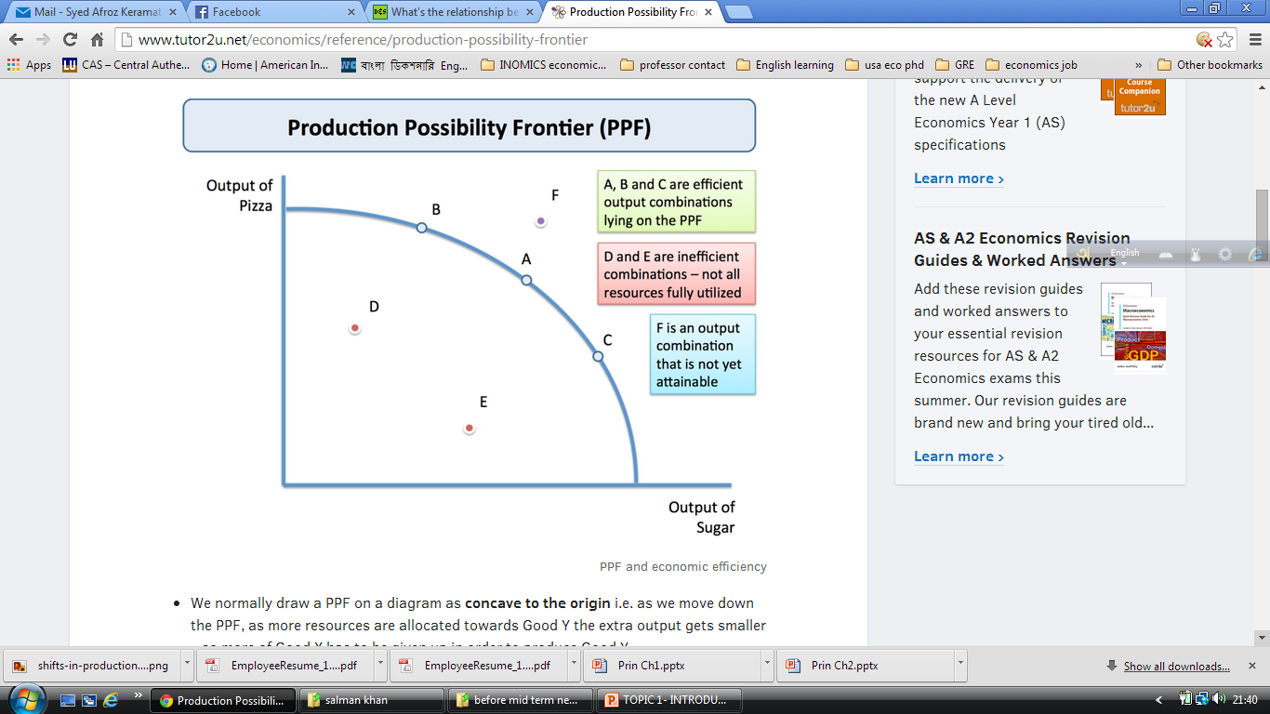
Production Possibilities Frontier
Every point along the curve is efficient; points outside the curve are unobtainable and inside curve are inefficient

Slide 16
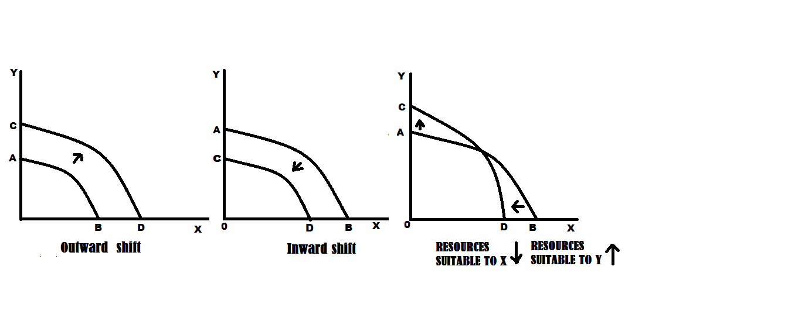
Shifts in the PPF

Slide 17
Causes of Shifts in the PPF
Shifts in the production possibilities curve are caused by changes in these things:
• Advances in technology
• Changes in resources
• More education or training (that's what we call human capital)
• Changes in the labor force

Slide 18
Production Possibilities Frontier
Concepts Illustrated by the Production Possibilities Frontier :
Efficiency
Trade-offs
Opportunity Cost
Economic Growth
Significance of PPF:
Where shall the choice of society lie?
It helps to solve 3 basic problems : what to produce; how to produce; for whom to produce.
To study economic development.

Slide 19
Thank You

